Slide 1
Web Based Information Visualization Tools
Presented by:
Cydnelle Alemao,
Nilesh Jakamputi,
Taylor Grant.

Slide 2
Agenda
Introduction - Overview of Web Based Visualization tools.
Google Charts.
D3.js.
Mapbox.
Demonstration of Google Charts, D3.js, Mapbox.

Slide 3
Introduction
Web-based visualization tools are software tools / frameworks that enable users to create and share interactive visualizations and data-driven graphics on the internet. These tools typically work through a web browser and often allow users to create custom visualizations without requiring any programming knowledge.
There are many different types of web-based visualization tools available, each with their own strengths and weaknesses. Some of the most popular web-based visualization tools include:
Google Charts
D3.js
Tableau
Power BI
Plotly
Mapbox

Slide 4
Google charts
Google Charts provides a rich graphics library with a large number of ready-to-use chart types, from simple line charts to complex hierarchical tree maps.
Google Charts is highly interactive and exposes js events that let you connect charts to create complex dashboards or other experiences integrated with your webpage1.
It is easy to work with dynamic data and connect your data in real-time using a variety of data connection tools and protocols.
Google Charts is free to use and provides cross-browser compatibility (including VML for older IE versions) and cross-platform portability to iPhones, iPads, and Android. Your users will never have to mess with plugins or any software.
Essentially , If they have a web browser, they can see your charts.

Slide 5
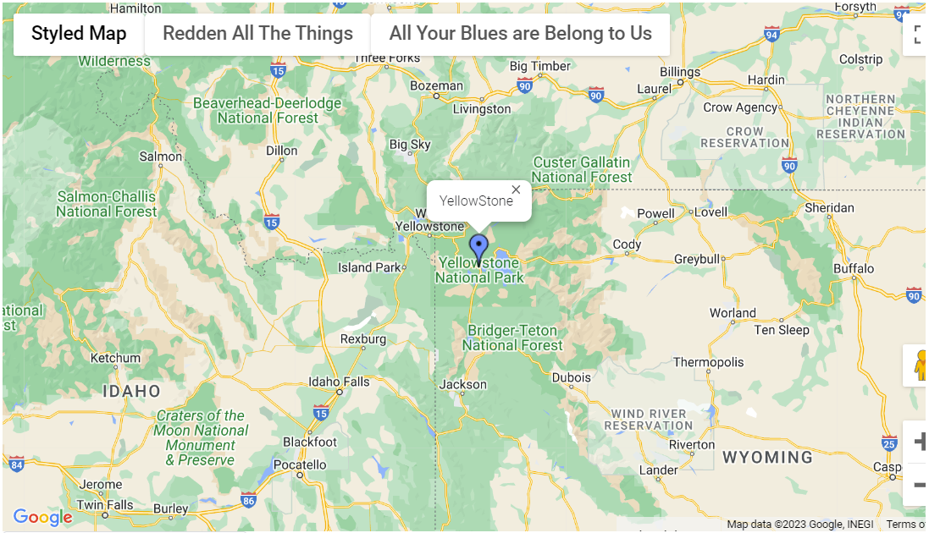
Images

Slide 6
Google Charts
Pros:
Easy to use API, even for beginners
Offers a variety of pre-built chart and map types that you just have to call.
Customizable with various options such as color schemes and labels
Free to use
Cons:
Limited flexibility compared to other tools, only a few dozen pre-defined charts
Limited options for granular customization
May not be suitable for more complex visualizations

Slide 7
D3
Data Driven Documents
JavaScript library for manipulating documents based on data
Uses web standards such as HTML, SVG, and CSS
Can handle large and complex datasets
Offers a wide range of data manipulation and visualization methods, including selections, transitions, scales, and layouts
Highly extensible and can be used with other libraries and frameworks to create complex visualizations

Slide 8
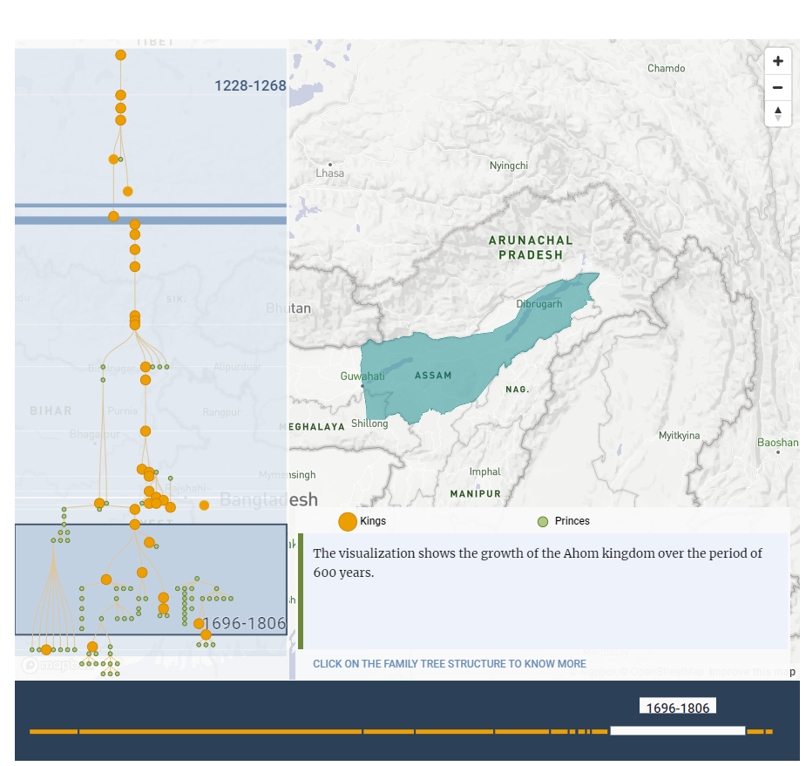
D3 Example:
Infographic made using D3.js. This infographic Is about the rise and fall of an Empire in Assam, India.

Slide 9
D3
Pros:
Offers unparalleled flexibility and customization options
Wide range of tools for manipulating and animating data
Great for creating complex and dynamic visualizations
Free and open-source
Cons:
Requires programming skills
Flexibility comes with Steep learning curve for beginners
May take longer to create visualizations compared to other tools

Slide 10
Mapbox
Mapping and geospatial data visualization tool
Offers a wide range of map styles and customization options
Used for visualizations, such as geospatial analysis, location tracking, and data-driven mapping
Variety of pricing plans available, including a free tier for limited use
Provides a range of integrations with other tools and platforms
Examples: Uber Eats, Ford, Snapchat
Mapbox Gallery

Slide 11
Mapbox
Pros:
Customizable Maps
Scalability
Integration
Pricing Plans
Cons:
Not suitable for non-geospatial data visualizations
Can be expensive for larger-scale use
Data Limits
Limited support for non-technical users

